Slide 1

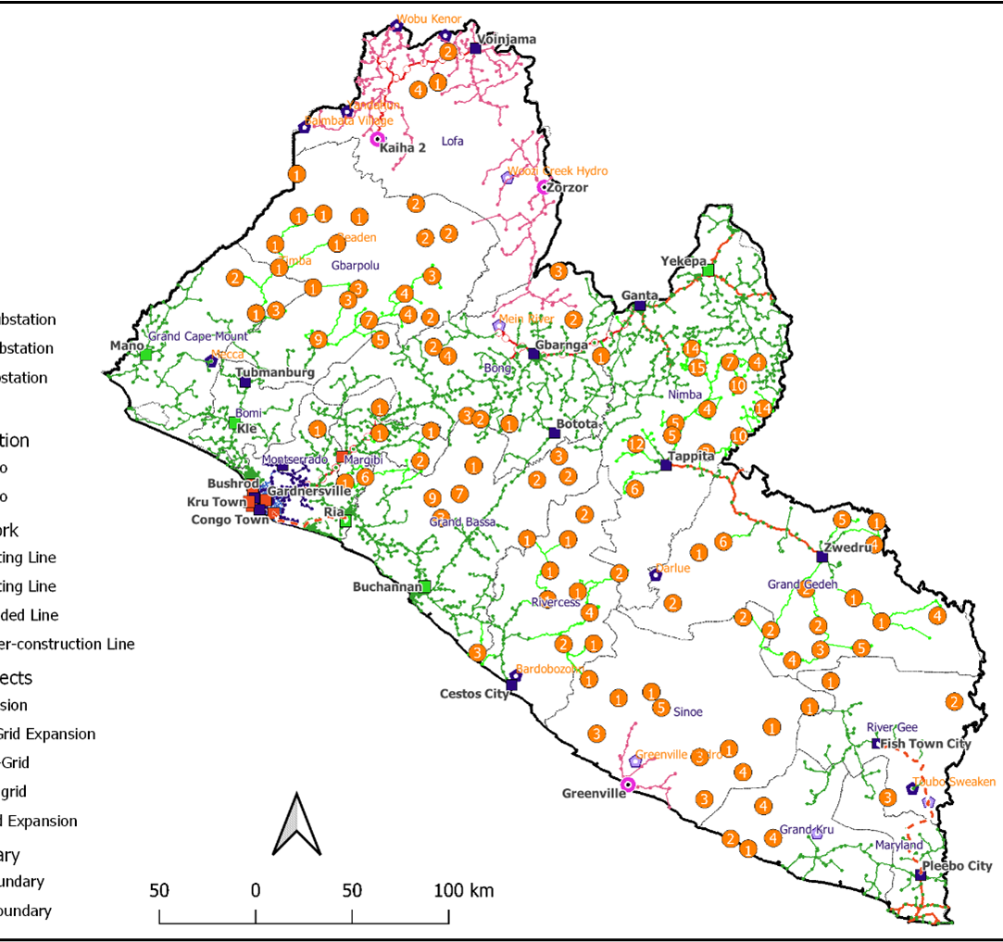
Liberia Presentation
Global Off-grid Solar Forum & Expo
Kigali, Rwanda
October 2022

Slide 2
Table of Contents
Socio-economic data
Energy access and climate change
Off-grid energy policy, legal & regulatory framework
Off-grid energy initiatives, challenges & lessons learnt
Private sector participation opportunities in off-grid sector
End-user subsidy Results-based financing for SHS
PVOC-linked Duty waiver on off-grid energy products

Slide 3
Socio-economic data
Population(estimated): 5,073,296
Country group: Least developed, low-income economy
Gross Domestic Product (GDP): $3.222 billion (nominal, 2019 estimate)
GDP per Capita: $704 (nominal, 2019 estimate)
GDP Rank: 158th (nominal, 2019 estimate)
GDP per Sector: Agriculture-34%, Industry-13.8%, Services- 52.2%
Main industries: mining (iron ore, gold, diamond), rubber & palm oil processing
Human Development Index: 0.465 (2018); 176th ranking
Social Factor index: 52.3 out of 100
Life expectancy: 64 years
Median age: 19 years
Population in poverty: 40.9%

Slide 4
Energy Access & Climate change
Electricity and Climate Change Targets & Current Access
GHG Emissions reduction(NDC) targets: reduction by 64% by 2030
Current GHG Emissions: 0.02% of global emissions, but among 5 most vulnerable countries to climate change
NEA Electrification access targets: 100% by 2030; with 70% of population to be electrified by main grid, 5% by large mini-grids, 6% by small mini-grids & 19% by solar home systems.
Current Electricity access rates per areas: 20% in urban areas & ≤5% in rural areas
Current Electricity access per technology:main grid 7%, offgrid 21%
Current Installed electricity generation capacity: 138 MW
RESMP Renewable electricity targets: 150MW or 75% share of electricity generation by 2030
Current Renewable electricity generation capacity: 88 MW (64% share of generation)

Slide 5
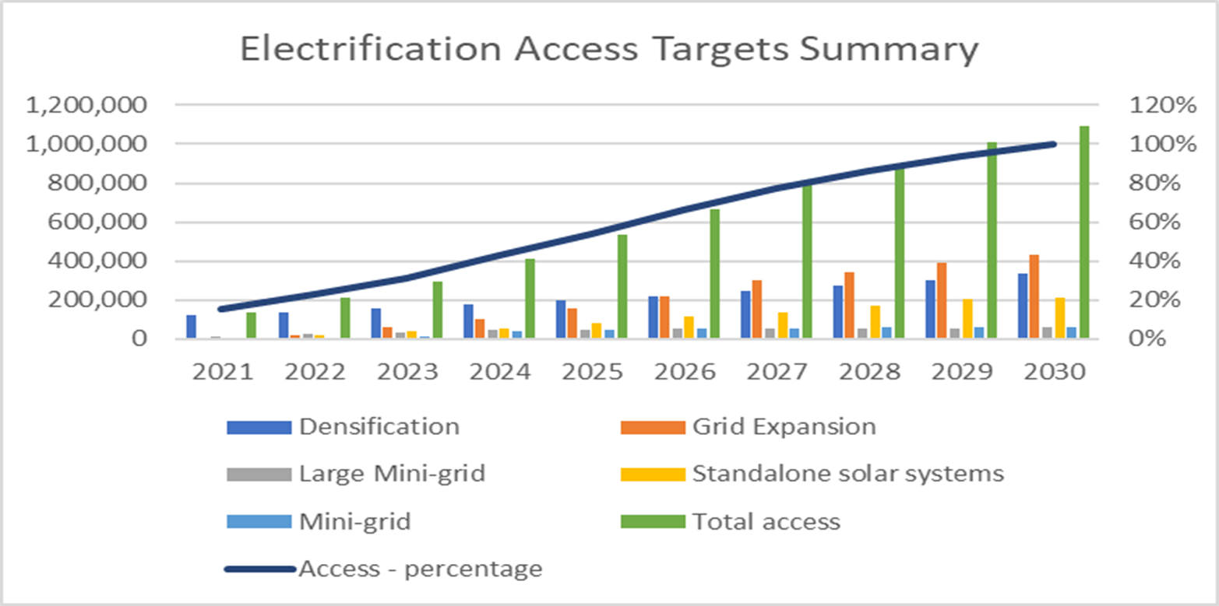
Energy Access & Climate change

Slide 6
Energy Access & Climate change
Other than Electricity Access Targets as per RESMP:
Universal use of pre-paid meters from 2020 onwards and availability of 1 Amps,
Total energy losses on rural electricity below 12% by 2030,
Universal access to efficient lights, TVs, refrigerators and freezers at affordable prices,
Solar Water Heating suppliers and installers available in every County Capital,
Cooking gas available in all County Capitals and gas stations at affordable prices with at least one reception and storage facility in Liberia,
Universal access to affordable and efficient locally manufactured cook stoves with the target of 250.000 efficient cook stoves sold until 2030,
Increase the share of efficient charcoal production to 60% by 2020 and 100% by 2030

Slide 7
Off-grid Energy Policy, Legal & Regulatory Framework
2009 National Energy Policy: goal to ensure universal access to modern energy services in an affordable, sustainable and environmentally friendly manner in order to foster the economic, political and social development of Liberia. It laid the basis for several energy sector reforms including the establishment of the Rural and Renewable Energy Agency(RREA) and enactment of the 2015 Electricity Law.
2015 Act Establishing RREA: with mandate to facilitate and accelerate the economic transformation of rural Liberia, by promoting the commercial development and supply of modern energy services to rural areas with an emphasis on locally available renewable energy resources. A rural energy strategy and masterplan laid out in 2015 with target to electrify 35% of rural populations by 2030 including other renewable energy targets including clean cooking.
2015 Electricity Law: laid out to unbundle monopoly of the state utility to serve as national utility company and as transmission system operator; allowing private sector participation in electricity generation, distribution and sale. Also served as a legal basis for establishment of the Liberia Electricity Regulatory Commission.
Electricity sector regulations: issuance of several regulations including Electricity Licensing, Micro-utility licensing, Grid code, Mini-grid code, Distribution code, Customer Service & Quality of Supply, Multi-year Tariff Methodology, Tariff Regulations, Technical regulations on solar energy (in draft).

Slide 8
Off-grid Energy Policy, Legal & Regulatory Framework
Mini-grid Policy: lays out strategy for electrification by deployment of mini-grids(isolated and inter-connected) with private sector participation by solicited proposals (through international competitive bids on a Lease-Operate-Transfer arrangement) & unsolicited proposals (through award of grants on a Build-Own-Operate or Build-Own-Operate-Transfer arrangement).
National Electrification Strategy: least cost geospatial plan to accelerate/expand electrification to achieve universal access by 2030 with 70% of population to be electrified by main grid(expansion & densification), 5% by large mini-grids, 6% by small mini-grids & 19% by solar home systems.
Executive Order # 107: issued by the President for one year period suspending import duty on quality-verified solar photovoltaic products, appliances and system components. Technical regulations and Pre-export Verification of Conformity importation guidelines are being finalized as framework for implementation.

Slide 9
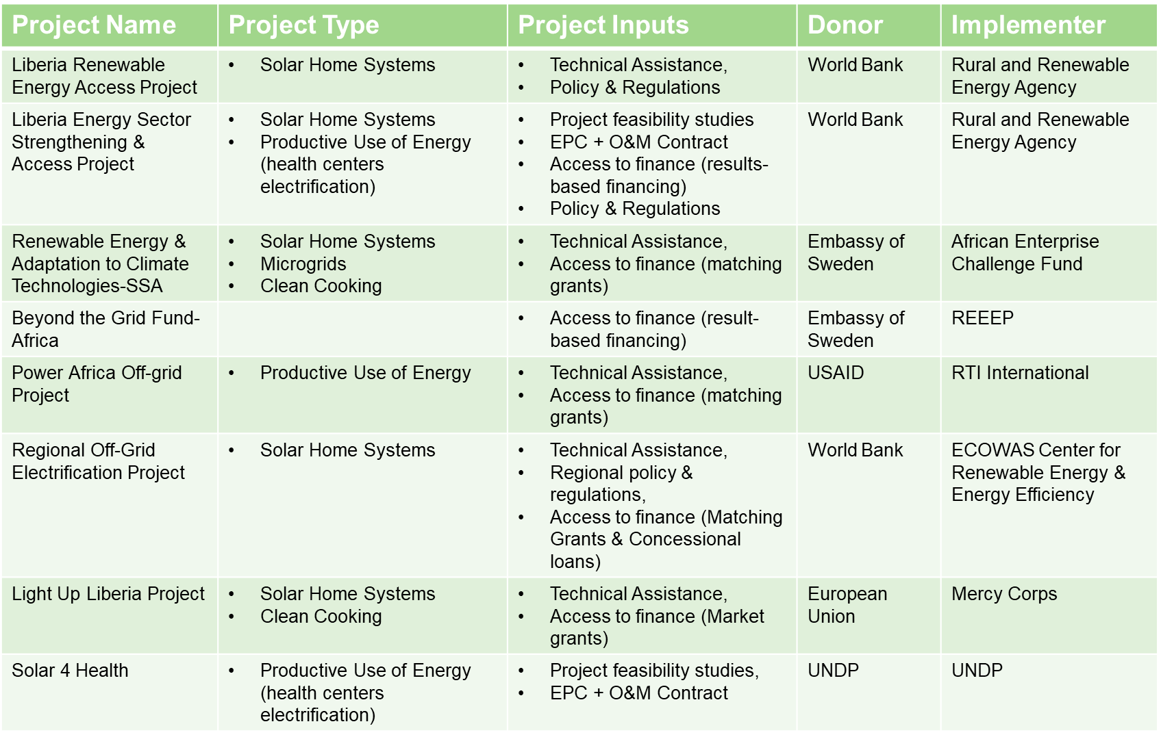
Ongoing Off-grid Energy Initiatives

Slide 10
Off-grid Energy Initiatives-Challenges & Lessons learnt
Limited households affordability
Limited access to finance for SHS Companies
Limited technical capacity for installation & maintenance of solar PV systems
Lack of regulatory environment for installation & maintenance of solar PV systems
Competition from low-quality products, appliances and components
Uncertainty on grid extension & mini-grid electrification programs
Poor road infrastructure for distribution networks
Limited telecommunication network coverage
Fragile economy (fluctuations of exchange & interest rates)

Slide 11
Private Sector Participation Opportunities in Off-grid sector
Through new market entry or partnership with local firms:
Agricultural Productive Use of Energy offgrid systems: given the high demand for processing, storage & preservation of agricultural outputs such as rice, cassava, rubber, aquaculture etc,
Solar Home Systems: given the low access to electricity rates mainly in rural areas (≤5%) and targets to electrify 19% of households through stand-alone systems by 2030,
Clean cooking: given the targets as per the Rural Energy Strategy & Masterplan to distribute 250,000 units of clean cookstoves, availability of cooking gas into county capitals, and increasing the share of efficient charcoal production to 60% by 2020 and 100% by 2030.
Liberia Energy Sector Investment Forum
November 9-10, 2022 in Monrovia, Liberia
BOOK YOUR CALENDAR

Slide 12
End-User Subsidy Results-based Financing for SHS
Joint implementation of a World-Bank funded Liberia Energy Sector Strengthening & Access Project and DGIS-funded EnDev Demand-side Subsidy program in 4 Sub-Saharan African countries:
LESSAP Off-grid Phase I pilot:
    Geographical focus: rural & semi-urban Liberia
    Implementation period: Jan 2021 to June 2026
    Funding envelope: US$ 2million
    Targeted beneficiaries: 6,500 households
    Eligible technologies: VeraSol certified solar home systems ≤350Wp
    Targeted regions: last-mile poor rural & semi-urban offgrid areas
    EnDev Global Demand-side subsidy component:
    Geographical focus: 4 countries in Sub-Saharan Africa including Liberia
    Implementation period: Aug 2022 to Sept 2025
    Target group: Marginalized / low-income households
    Eligible technologies: Off-grid solar or clean cooking (depending on country context and scale-up potential)
    Expected results across all countries: 1,000,000 persons
    Funding envelope for Liberia: € 3.8 million for DSS pilots on off-grid solar

Slide 13
PVOC-linked Duty waiver on off-grid solar PV products
Importer obtains a License of Importation from RREA
Importer obtains a Certificate of Conformity from PVOC Service Provider after pre-shipment inspection
Importer obtains Quality Certificate from NSL after a Conformity Report from the PVOC Service Provider
Importer ships consignment
Importer obtains Duty Waiver Authorization from LRA
Consignment delivered and inspected at port of entry
Importer takes delivered of compliant consignment of products

Slide 14

Thank You

